Slide 1

Bachelor's Thesis Proposal
Alberto Ottimo
University of Pisa - Italy

Slide 2

Stream Processing

Slide 3
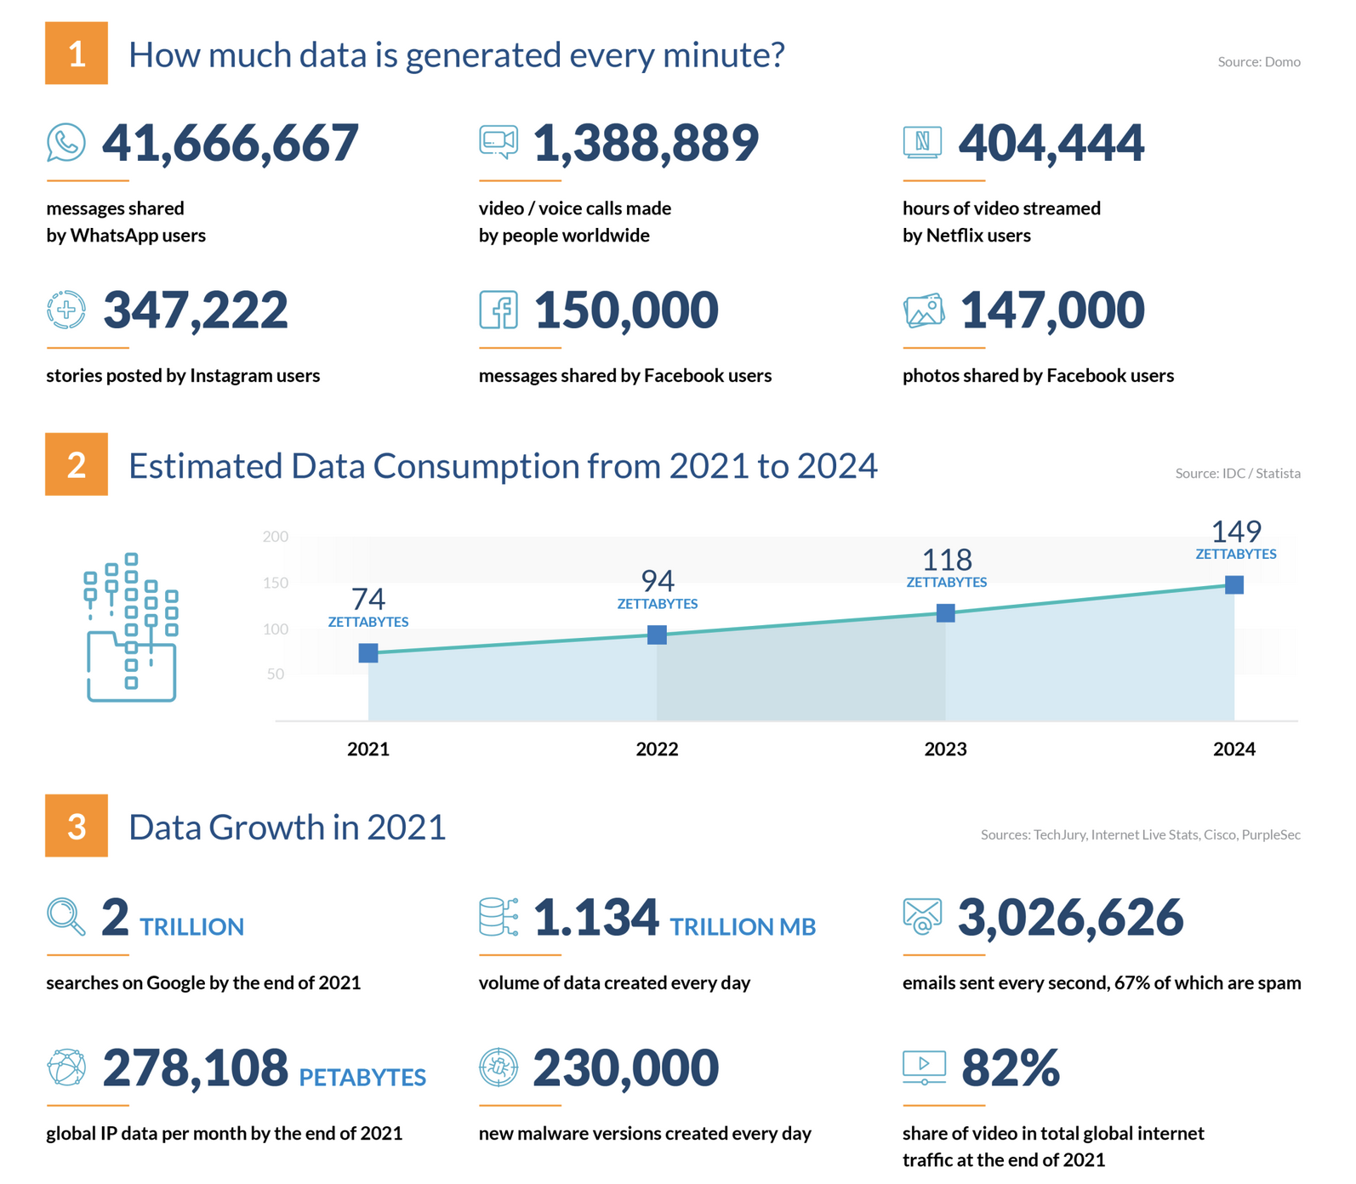
Data Streams Deluge
New sources of data have become available
sensors, mobile phones
social networks
video cameras
IoT devices
>2.5 Exabytes of data produced each day (2022)
Most of data are available in the form of streams
How can we extract useful information from streams?
https://financesonline.com/how-much-data-is-created-every-day/

Slide 4
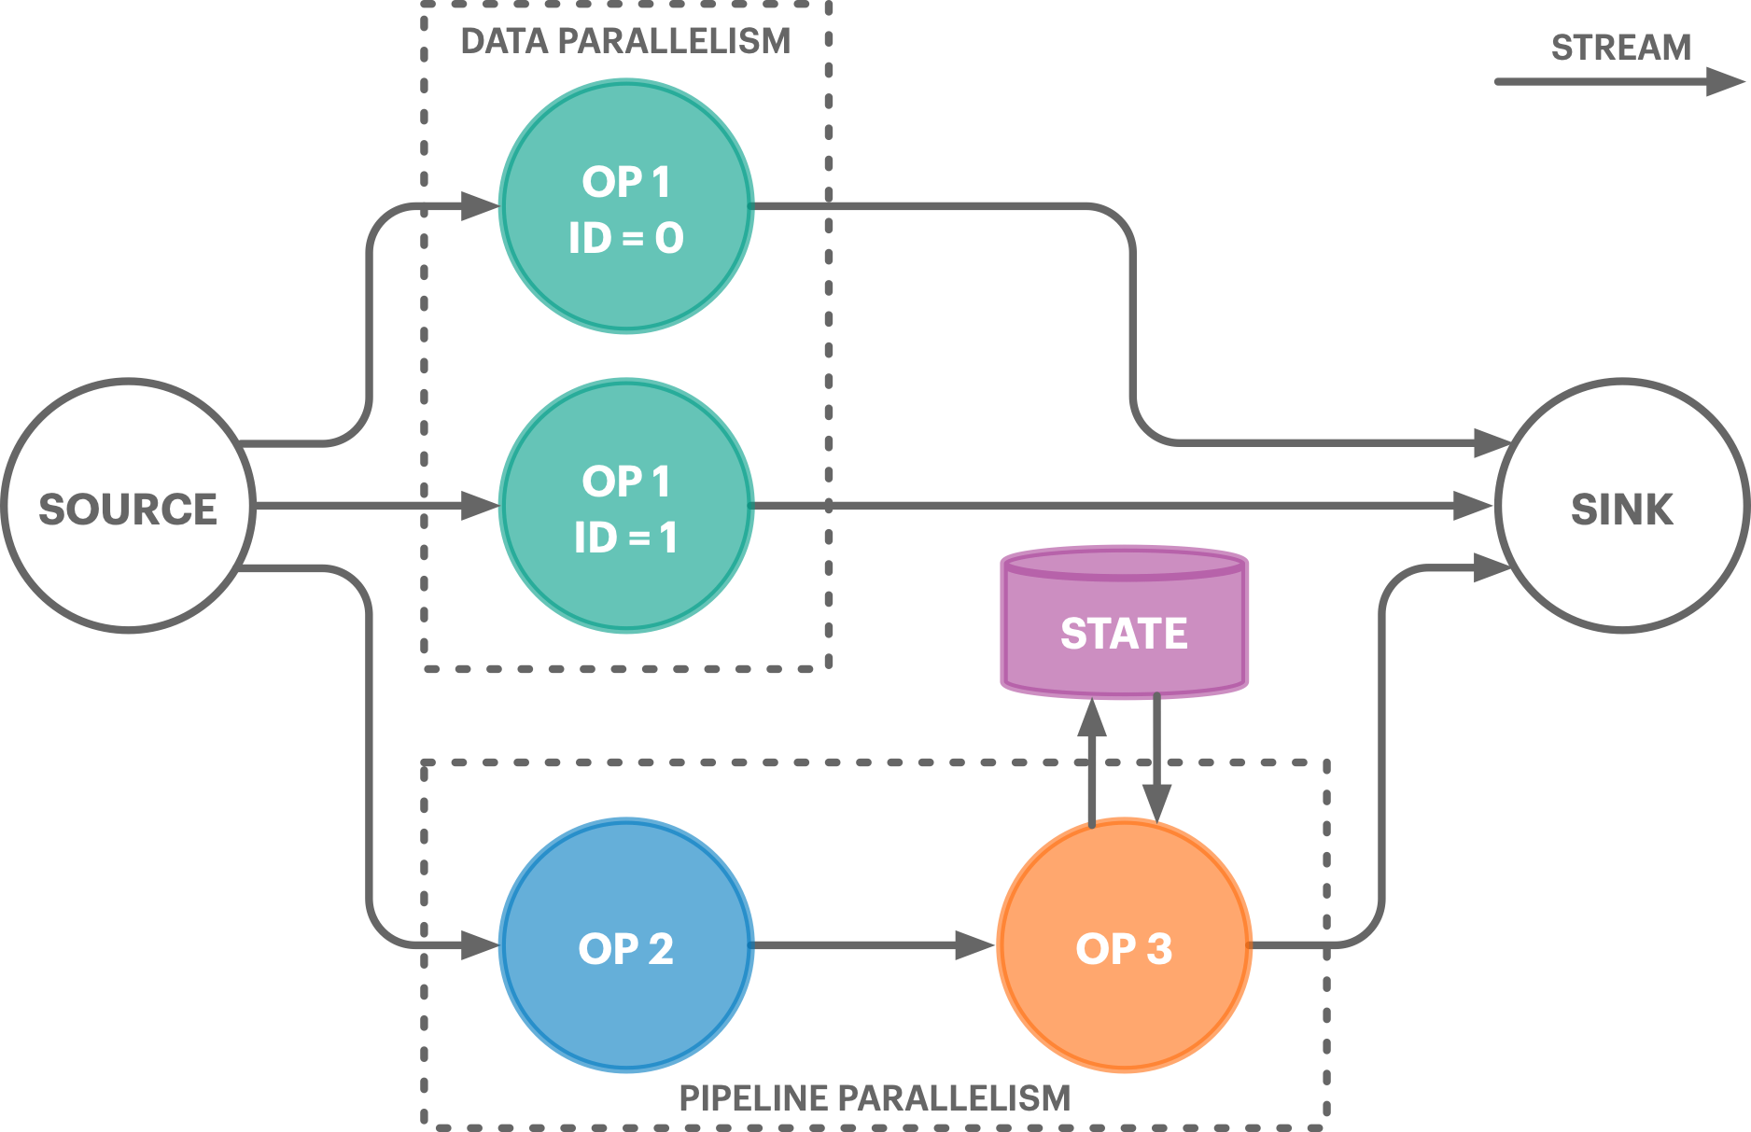
Stream Processing
Emerging computing paradigm related to the continuous processing of data streams to extract analytics and complex events with real-time requirements (i.e., high throughput & low latency)
Applications are Direct Acyclic Graphs (DAGs)
Operators
Stateless and (partitioned) Stateful
SQL-Operators, Map, Filter, FlatMap
Windowed (e.g., tumbling, sliding, ...)
Streams
define dependencies among operators

Slide 5




Which Tools to Process Streams?
Stream Processing Engines (SPEs) are frameworks and libraries to help programmers in developing and deploying stream processing applications
Relational SPEs: continuous queries over structured data streams
General-Purpose SPEs:
arbitrary continuous operations over streams of structured or unstructured data
operators includes user-defined functions provided with an imperative/functional programming language like Java, Scala, Python, C++, etc.
Mainly targeting multi-core CPUs, GPUs, distributed homogeneous nodes

Slide 6
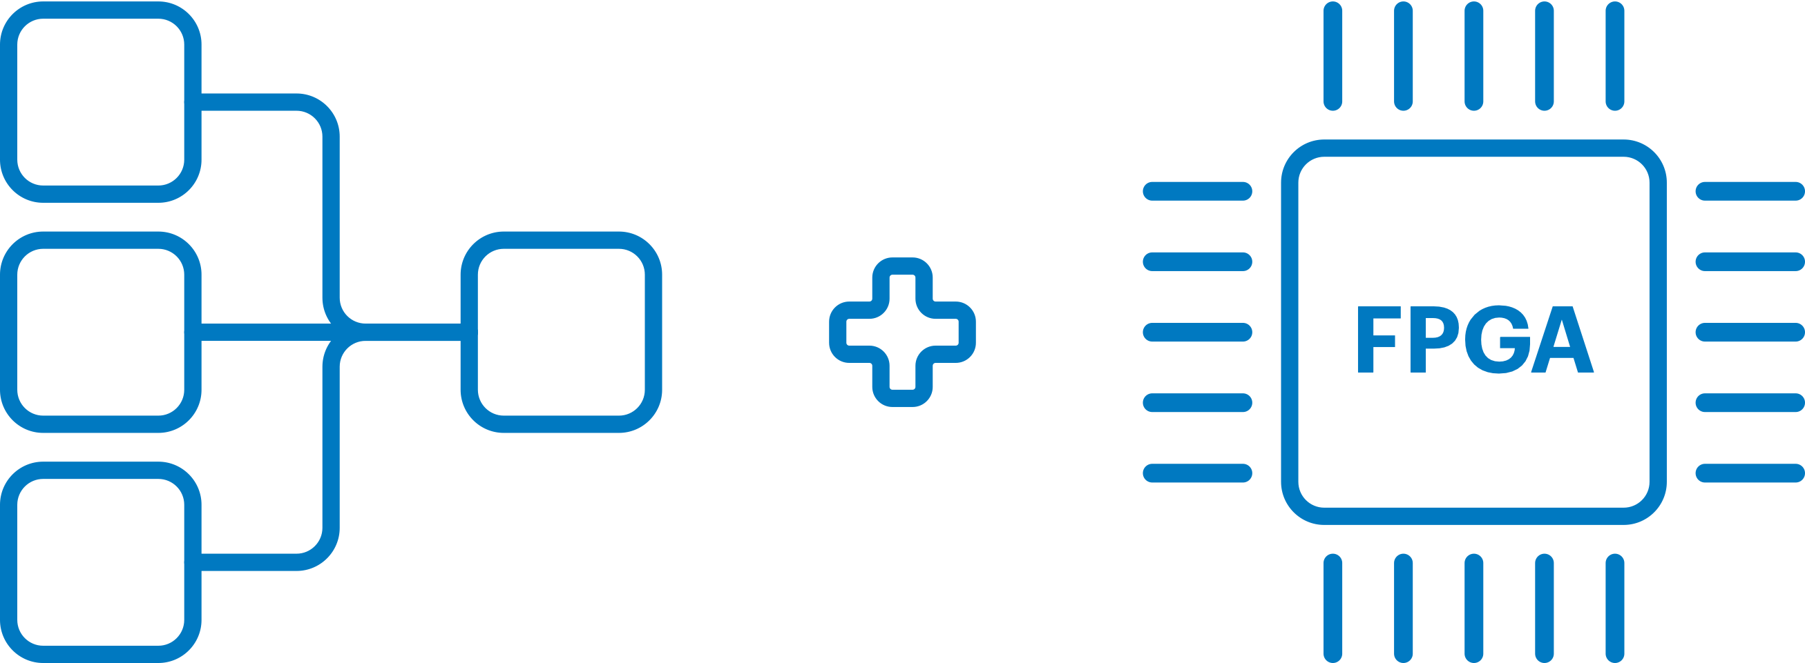
FSPX

Slide 7
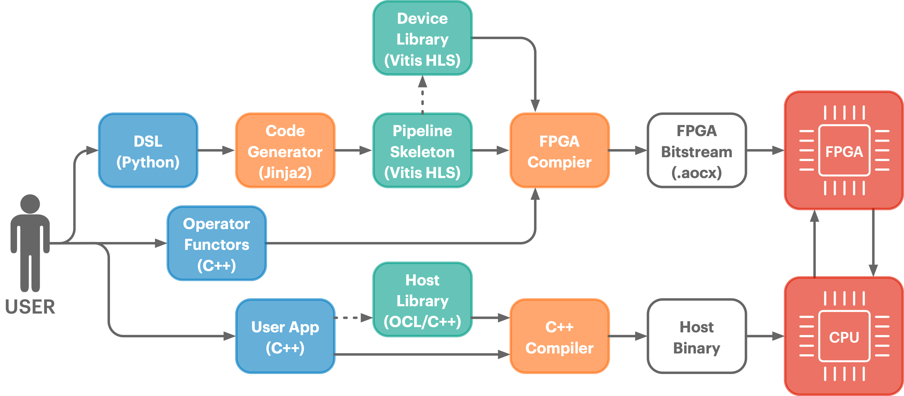
FSPX - Overview

Slide 8
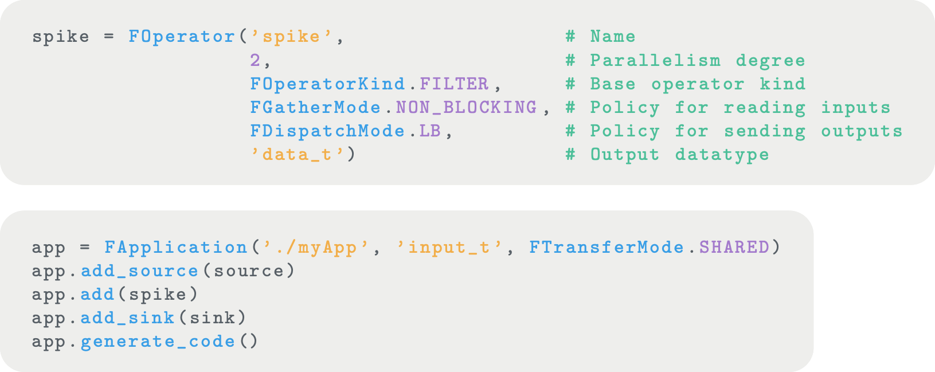
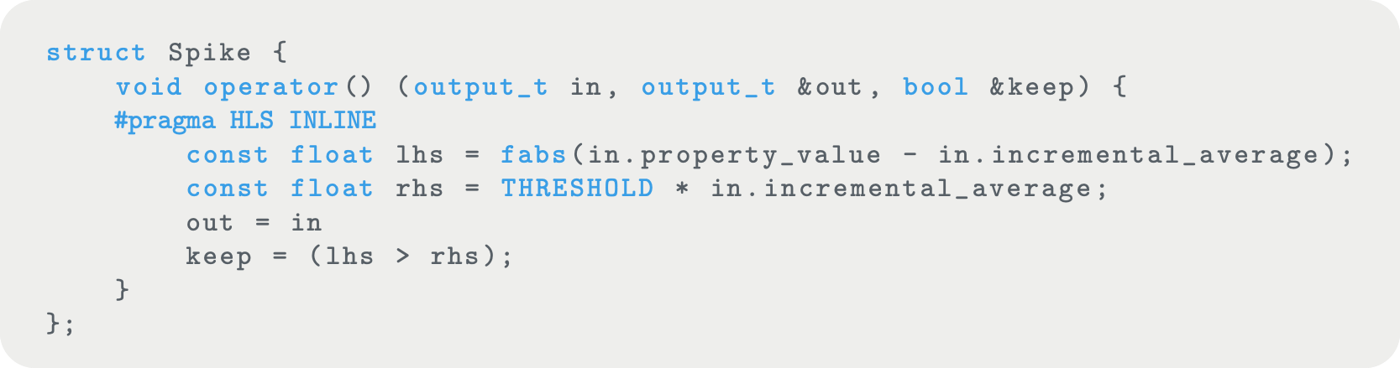
FSPX - Python-based DSL
Operators (Map, Filter, Source and Sink)
Parallelism degree
Gathering (blocking/non-blocking)
Dispatching (RoundRobin or Key-by)
Output datatype
State (private, local, and global)
Pipeline (connect operators)
Code generation
Host: headers library to interact with the FPGA
Device: OpenCL/VitisHLS skeleton and runtime

Slide 9

Thesis Proposal

Slide 10
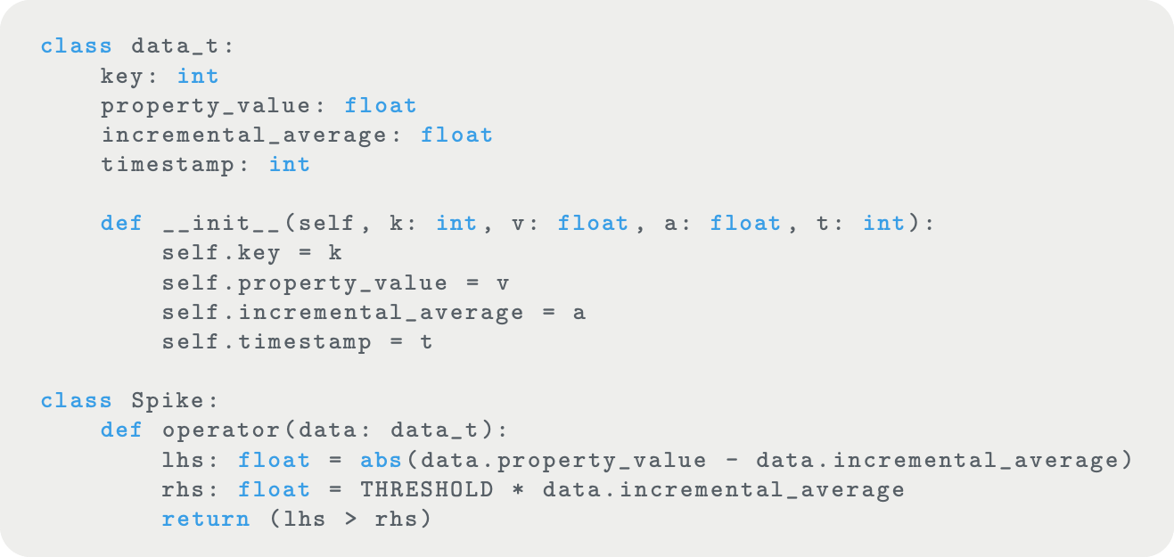
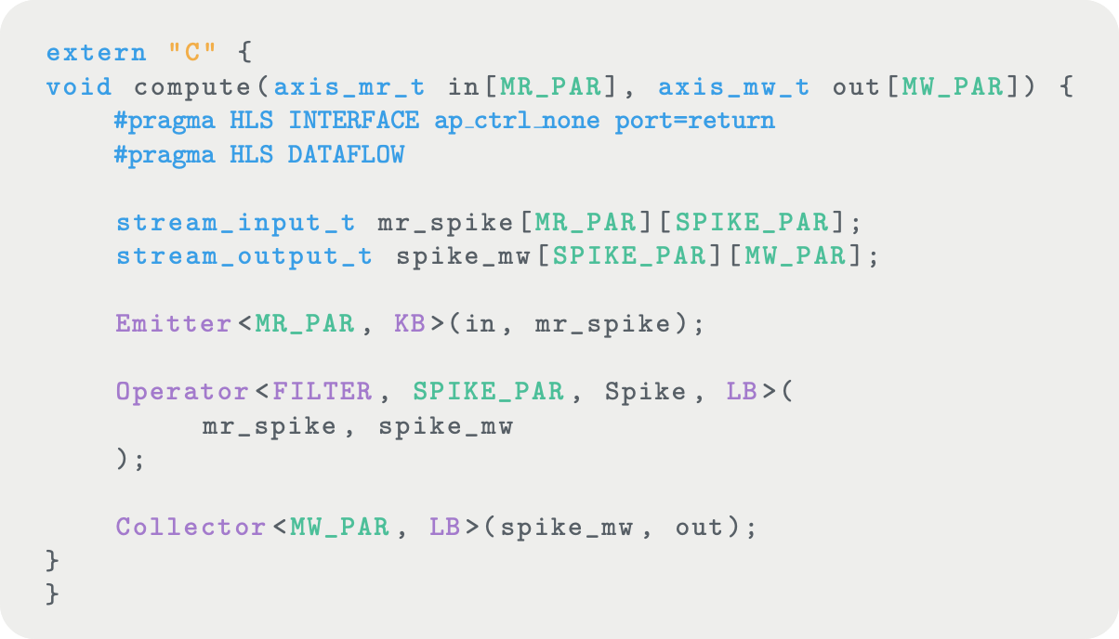
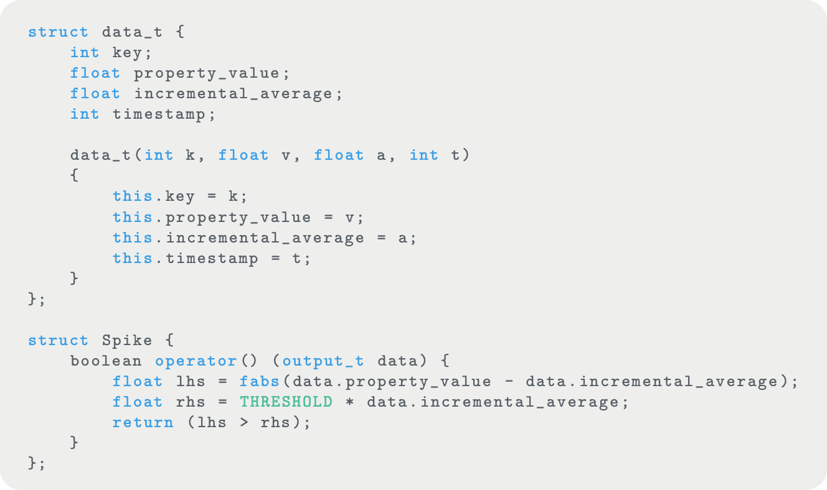
Overview
Python Type Hints
Python
C++ / Vitis HLS

Slide 11
Python --> C++ / Vitis HLS
General idea: Python transpiller to C++ / Vitis HLS
Vitis HLS can "compile" only a subset of C++ (see: Unsupported C/C++ Constructs)
NO System Calls
NO Dynamic Memory Allocation (e.g, malloc, free, etc.)
NO Recursive Functions
NO Standard Template Libraries (as it contain function recursion and use dynamic memory allocation)
NO Virtual Functions
...
as a consequence Python scripts cannot contain:
code using external libraries such as Numpy, Matplotlib, etc.
builtin functions such as list.append() or list.extend()
decorators
...

Slide 12
Python --> C++ / Vitis HLS Approaches
FSPX
Other Language
C++
Vitis HLS
Python
Python AST
Vitis HLS LLVM Backend
FPGA Bitstream
LLVM IR

Slide 13
Links
Other Language
Python → 11l → C++ transpiler: https://11l-lang.org/transpiler/
Prometeo: https://github.com/zanellia/prometeo
Python AST
Python AST: https://docs.python.org/3/library/ast.html
AST Unparse: https://github.com/simonpercivall/astunparse
DACE: https://github.com/spcl/dace/blob/master/dace/codegen/cppunparse.py
Transpyle: https://pypi.org/project/transpyle/
cgen: https://github.com/inducer/cgen/tree/main
LLVM IR
Pylir: https://github.com/Pylir/Pylir
Vitis HLS LLVM: https://github.com/Xilinx/hls-llvm-examples
Others
Shedskin: https://github.com/shedskin/shedskin
Nuitka: https://github.com/Nuitka/Nuitka
Codon: https://github.com/exaloop/codon

